Slide 1
THE DISASTER RISK MANAGEMENT - CLIMATE CHANGE ADAPTATION NEXUS
Allan Lavell
Regional Policy Dialogue on
Disaster Risk Reduction Best Practices for Climate Resilient Coastal Area Development
Bridgetown, Barbados
October 20-21, 2011
Notes:
25 minutes

Slide 2
Disaster and Climate Change: Critical Problems for the Caribbean
Second most disaster prone region in the world
Experiences $3 billion US Dollars in average annual disaster losses
One of the zones most susceptible to projected sea level and other climate change impacts
A good part of these effects will directly affect the highly critical coastal areas of the region

Slide 3
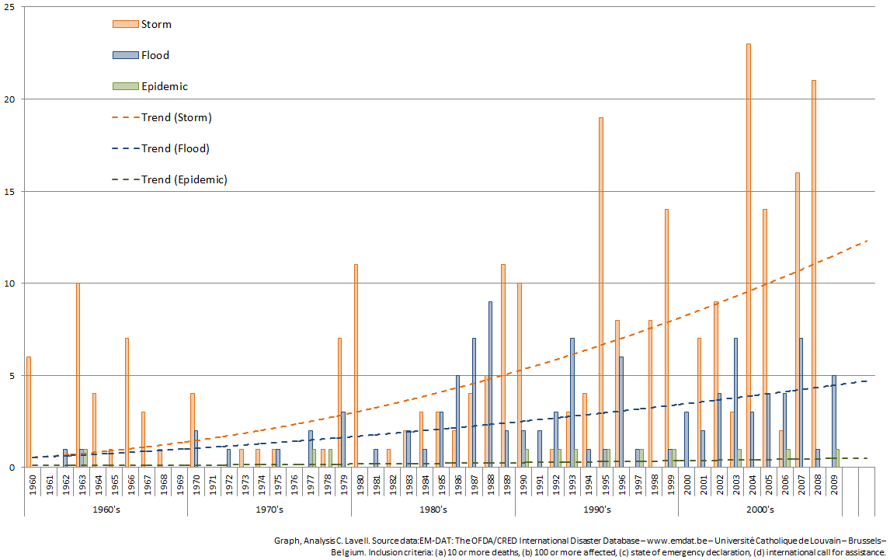
Annual number of hydro-meteorological disasters in the Caribbean region, 1960-2009

Slide 4
Annual number of hydro-meteorological disasters in the Caribbean region, 1960-2009
Rapid increase in small and medium sized storm and flood disasters which reflect skewed development practices
Trend in storms is growing much faster than the trend in floods and landslides, which is the opposite of what occurs at the global , world level
How to explain this discrepancy?
heightened storm-generation pressures from climate change?
large increases in exposure and vulnerability in the most susceptible regions?
In either case, the trends are too alarming to be ignored especially with new climate change pressures.

Slide 5
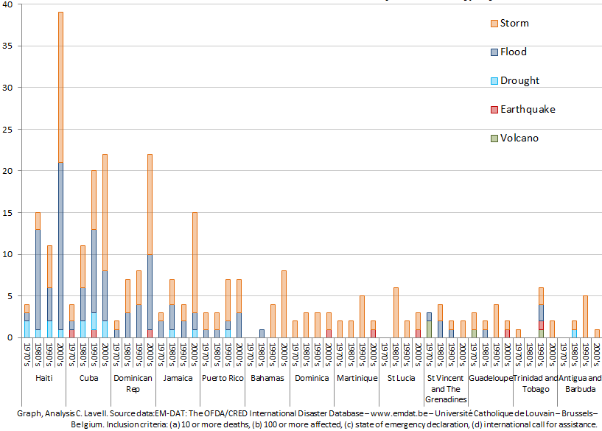
Number of disasters per Caribbean country, by decade from 1960 to 2009, top 13 countries
The countries represented on the left side of the graph have the total largest aggregate number of disasters ( Haiti, Cuba, Dominican Republic, Jamaica, and Puerto Rico)
All of these larger island territories demonstrate rapidly increasing inter-decadal trends in terms of the sheer number of disasters

Slide 6
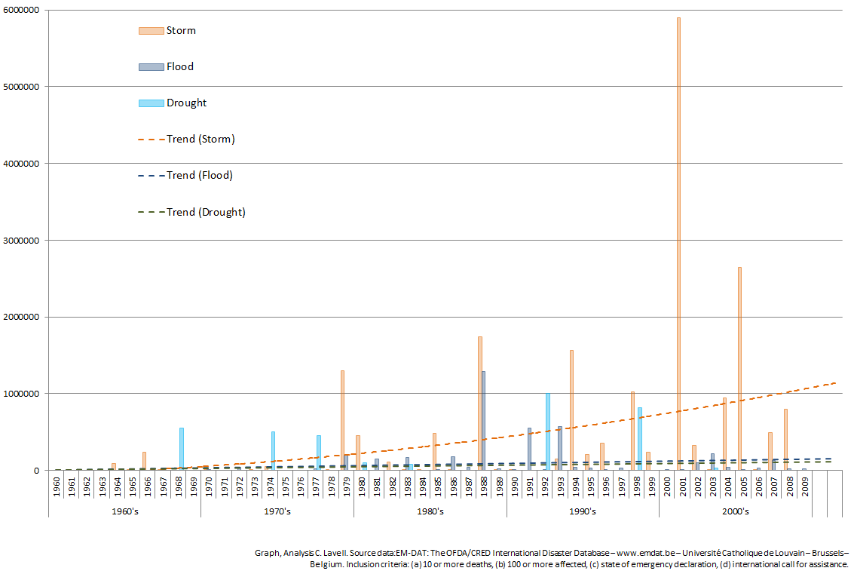
Annual population affected by disasters in the Caribbean region, 1960-2009

Slide 7
Annual population affected by disasters in the Caribbean region, 1960-2009
The number of people affected by storms is on the rise, and roughly similar numbers of homes are lost to both storms and floods
The number of people affected by storms in the region (and in contrast to global averages) is an order of magnitude greater than the other sources of disaster affectation in the region.
Figures for drought affectation have been of marginal significance in the past decade, although climate change models tend to indicate an increase in drought conditions in the area.

Slide 8
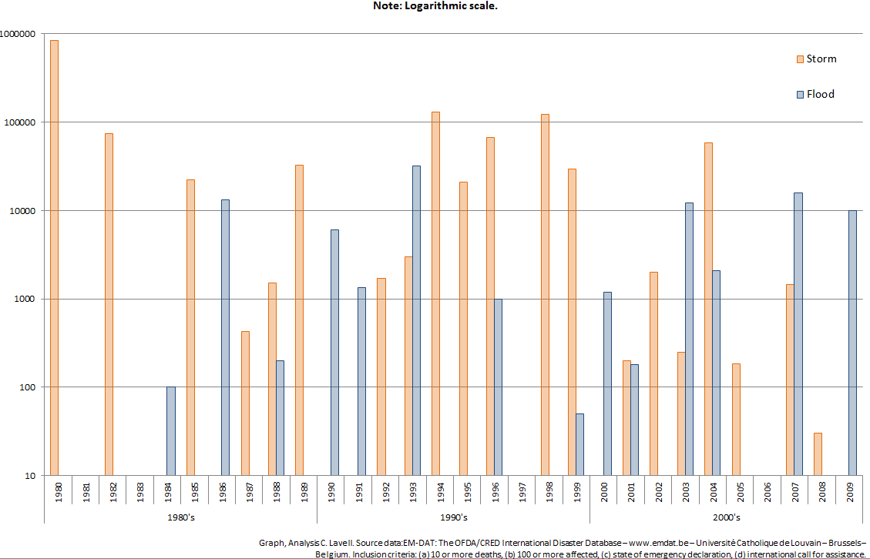
Annual number of homeless by hydro-meteorological disaster in the Caribbean, 1980-2009

Slide 9
Annual number of homeless by hydro-meteorological disaster in the Caribbean, 1980-2009
In the past 30 year period:
one year (1980) has approached 1 million homeless (3% chance per year),
five years have been in the neighborhood of 100,000 homeless (17%),
ten years have had around 10,000 homeless (33%), and
ten years have had around 1,000 homeless (33%)
Between the two sources of hazard, storms and floods, there are only five years (17%) in which there were fewer than 100 homeless
This underscores the regular nature of loss-generating events in the region, a pattern that typically leads to ongoing erosion of livelihood options, and thus greater vulnerability to the large events
The regular occurrence (50%) of storms that trigger annual homeless counts between the 10,000 and 100,000 level is a clear indicator of the scale and frequency of typical intensive events in the region

Slide 10
Historic Impacts of Hydro-Meteorological Events in the Caribbean
The Economic Commission for Latin America and the Caribbean (ECLAC) has calculated the following economic, social and environmental impacts from disasters (in terms of damage and losses) for the 1990-2008 period in the Caribbean sub-region:
The total impact (in damage and losses) was estimated at US $ 136 billion
The total economic impact was US$ 63 billion (46% of total impact),
The social cost was US$ 57 billion (42% of total impact),
The total infrastructural damage was approximately US$ 12 billion (9% of total impact)
Damage to the environment was US$ 3.5 billion (3% of total impact).

Slide 11
Climate Change: Physical and Environmental Impacts: Sea Level Rise
“Sea level rise (SLR) of around 1.5 to 3 mm per year have been observed at tidal gauging stations around the Caribbean.“ (CARIBSAVE 2009, pg. 86).
“Even in the absence of increased intensity or frequency of tropical storms and hurricanes, SLR will intensify their impact on coastlines in the Caribbean.” (UNDP 2010, p.74)
A World Bank (2009) study on Sea Level Rise and Storm Surge in Jamaica concludes that there could be a 56.8% increase in affectation in the future, with 26.6% of the coastal population exposed and potential losses of coastal GDP projected to exceed 26.7%.

Slide 12
Physical and Environmental impacts: Coral Bleaching
Physical impacts to the marine ecosystem also have knock-on economic impacts.
If current trends in coral reef degradation continue, we can expect to see annual losses, by 2015:
to fisheries in the $95-$140 million dollar range,
to dive tourism in the $100-$300 million dollar range
to shoreline services in the $140-$420 million dollar range

Slide 13
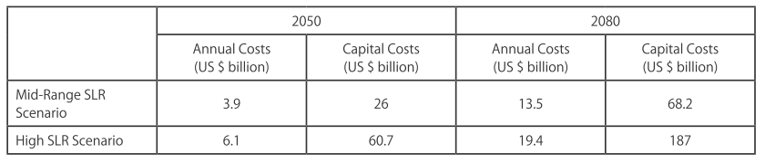
Economic Impacts
The UNDP study on Quantification and Magnitude of Losses and Damages Resulting from the Impacts of Climate Change by Simpson et al concludes that:
The Bahamas, Suriname, Guyana, Trinidad and Tobago and Belize are anticipated to suffer the greatest economic losses and damages in absolute economic terms.
In terms of the economic costs associated with the effects of SLR, and in particular on the increased effect of extreme events due to SLR, the costs can be divided into capital outlays on new or improved coastal defenses and costs related to maintenance, repair and improvement of existing assets.
For the improved defenses, construction costs are expected to be between $1.2 to $4.4 billion dollars, with ensuing annual maintenance costs somewhere above $100 million per year.
Figure #11: Annual and Capital Costs of SLR in CARICOM Countries (in 2010 US $) (UNDP 2010, p.52)

Slide 14
Comments Regarding Impacts
Considering a Caribbean population of approximately 36 million, historical trends in losses constitute an average of almost $4000 per capita over the 20-year period
Despite the tremendous amount of work that has taken place in dealing with the social and physical-environmental impacts, it is still much more difficult to quantify the losses in these categories
This difficulty of quantification translates into a lower degree of “visibility” of these problems amongst both policymakers and the general populace

Slide 15
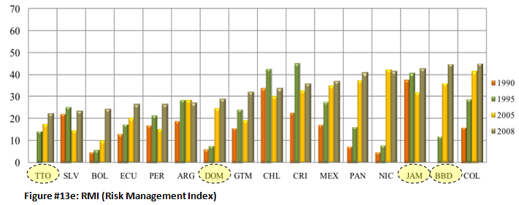
Risk Management Index
TTO = Trinidad & Tobago
DOM = Dominican Republic
JAM = Jamaica
BBD = Barbados

Slide 16
Similarities and Synergies between DRM and CCA
Response to non routine events, both extreme and non extreme, and the risk they imply
Fundamental importance of affecting exposure and vulnerability to damaging events and dealing with similar root causes in skewed development
Importance of local participatory approaches
Need for corrective and prospective management.

Slide 17
Similarities and synergies between DRM and CCA
Strategic approaches that DRM & CCA have in common:
Environmental service management
Land use planning and territorial organization
Livelihood support
Improved governance
Structural and non structural instruments are similar

Slide 18
Differences between DRM and CCA
DRM also deals with non hydrometeorological hazards
Use of terminologies and understanding of concepts
Importance of preparedness and response for DRM
Institutional and financial mechanisms

Slide 19
DRM practice informed by CC Impacts
Managing greater and different levels of uncertainty
Managing greater levels of hazard stress
Considering changing averages as disaster risk stressors
Deal with new stresses associated with sea level rise and direct impact on land based activity

Slide 20
Important elements of practice
We need to find approaches that go beyond existing sector, NGO, parish and other special interest group approaches to DRR in coastal areas.
Projects and programs that promote greater interconnectivity, harmony, integration and comprehensiveness in actions over narrow-focus approaches
structural approaches must be combined with “soft” approaches that seek to prevent the risk from being created altogether
--- incorporate both corrective and prospective risk management techniques.

